Slide 1

Comprehensive Banking Risk Analysis Using EDA and BI Tools
Embark on a journey through an end-to-end data analytics project, focusing on banking risk analysis and the creation of insightful dashboards. This presentation delves into the methodologies, tools, and best practices employed.

Slide 2
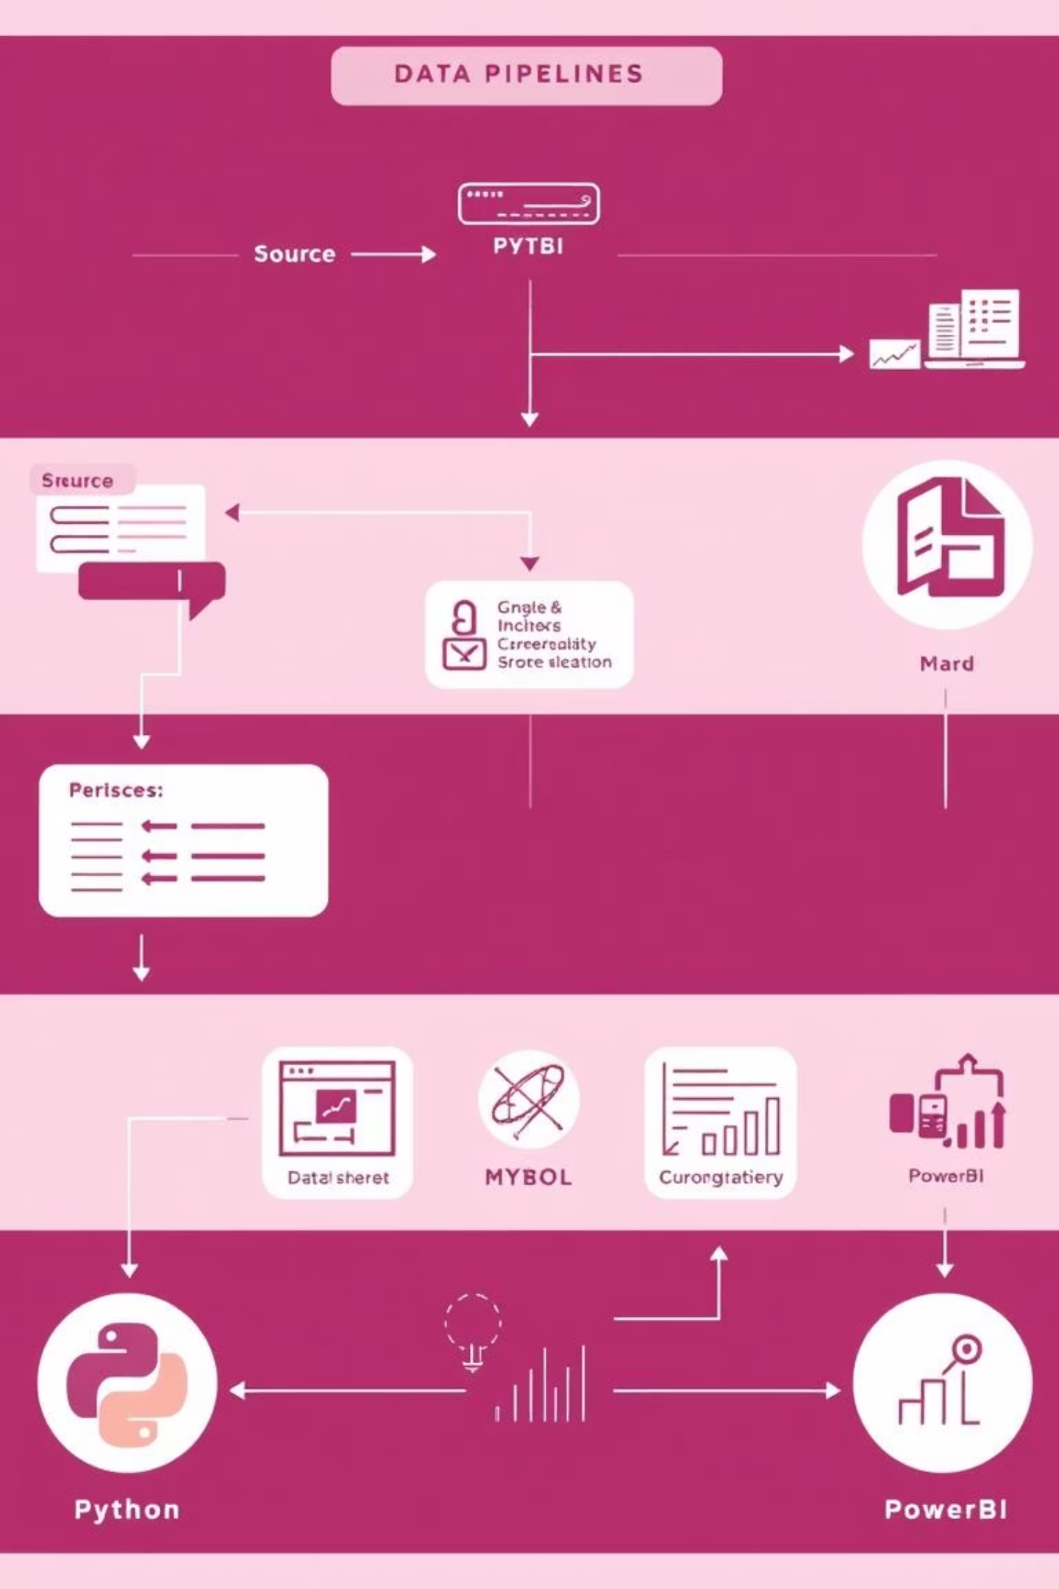



Project Overview and Objectives
This project aimed to perform comprehensive banking risk analysis, covering data cleaning, exploratory data analysis (EDA), and dashboard creation. We leveraged Python for data manipulation, MySQL for robust data storage, and PowerBI for interactive visualisations.
Scope & Objectives
Analyse banking datasets, identify risk patterns, and present actionable insights through interactive dashboards.
Key Tools Utilised
Python for scripting, MySQL for database management, and PowerBI for dashboarding.
Expected Outcomes
A deep understanding of banking risks and a functional, insightful PowerBI dashboard.

Slide 3
Understanding the Banking Dataset
The core of our analysis lies in a comprehensive banking dataset. It includes critical fields for risk assessment, such as customer demographics, loan statuses, transaction histories, and income bands.
Key Data Fields
Purpose & Utility
Customer ID & Demographics
These fields are instrumental in identifying potential credit risks, assessing customer behaviour, and detecting fraudulent activities, forming the backbone of our risk model.
Loan Amount & Status
Transaction Type & Value
Income & Credit Score
Payment History
Understanding each field's purpose is crucial for accurate analysis and informed decision-making.

Slide 4




Data Loading and MySQL Integration
Efficient data loading and management were critical. We established a robust connection between Python and MySQL, ensuring seamless data transfer and storage. This step laid the foundation for our analytical processes.
MySQL Database Setup
Created a secure and scalable MySQL database to store raw and processed banking data.
Python-MySQL Connection
Utilised Python's database connectors for efficient loading and querying of data into MySQL.
Data Integrity & Validation
Implemented checks to ensure data accuracy and consistency during the loading process.

Slide 5

Exploratory Data Analysis (EDA) with Python
EDA was a pivotal phase, allowing us to uncover hidden patterns and anomalies within the dataset. Python's powerful libraries were instrumental in performing statistical analysis, data cleaning, and creating insightful visualisations.
Data Cleaning Techniques
Statistical Analysis
Handling missing values, outlier detection, and data type conversions to ensure data quality.
Calculating descriptive statistics, correlations, and distributions to understand data characteristics.
Visual Methods
Utilising scatter plots, histograms, and heatmaps to visualise data relationships and trends.

Slide 6
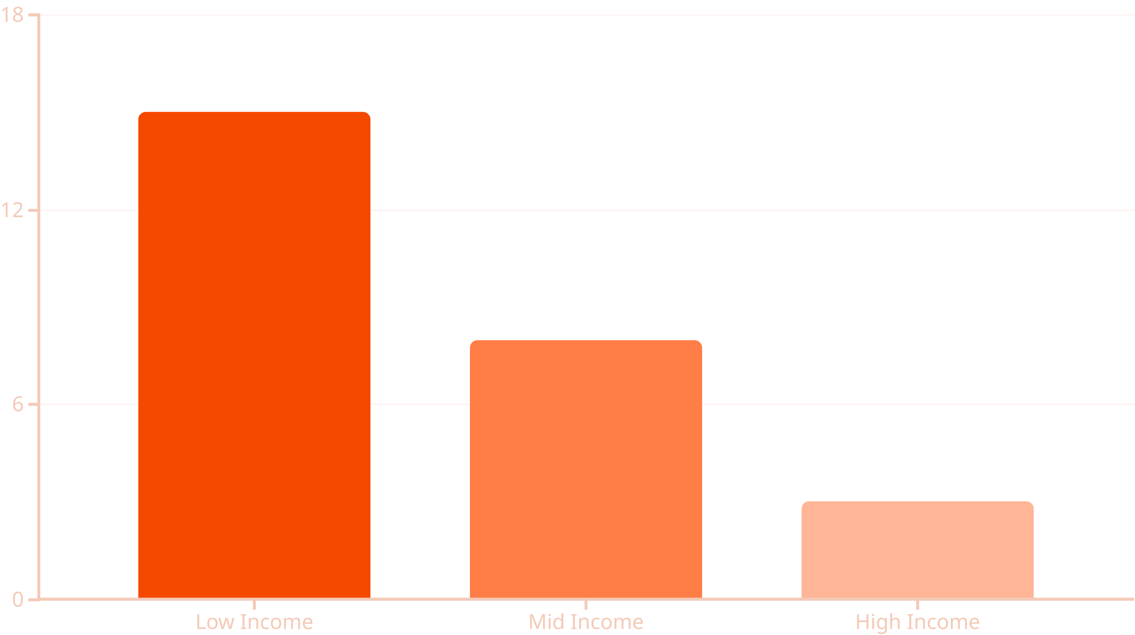
Key Insights from EDA and Risk Patterns
Through EDA, we identified critical patterns and correlations, particularly around income bands and loan default rates. These insights are crucial for proactive risk mitigation and strategic decision-making in banking.
The chart above illustrates the correlation between income bands and loan default rates, highlighting areas of higher risk.

Slide 7








PowerBI Dashboard Design & Implementation
The final output is an interactive PowerBI dashboard, meticulously designed to provide a comprehensive overview of banking risk. It includes a homepage with key performance indicators (KPIs), detailed loan and deposit analyses, and a customer behaviour overview.
Homepage Overview
Loan & Deposit Analysis
Consolidated view of key metrics and a quick risk summary for immediate insights.
In-depth breakdowns of loan portfolios and deposit trends, identifying growth and risk areas.
Risk Heatmaps
Customer Behaviour
Interactive heatmaps displaying risk concentrations across different parameters.
Visualisations of customer segments, transaction patterns, and loyalty metrics.

Slide 8
Conclusion: Learning Outcomes & Portfolio Value
This project significantly enhanced skills in Python, SQL, and PowerBI, along with a deeper understanding of banking risk analytics. It serves as a robust addition to any data analyst's portfolio, showcasing end-to-end project execution.
Skills Gained
Real-World Impact
Advanced Python for Data Analysis
Proactive Risk Mitigation Strategies
MySQL Database Management
Enhanced Decision-Making for Banks
PowerBI Dashboarding & Visualisation
Identifying Opportunities for Growth
Banking Domain Knowledge
Improved Customer Understanding
AI Tools for Efficiency (e.g., ChatGPT)

